Slide 1
Cre-don
Don’t bin it donate it

Slide 2
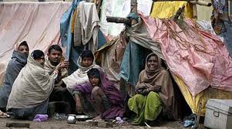
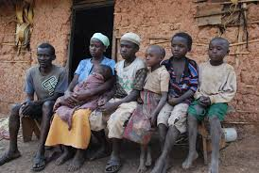
The lack of resources
As we know that in India a major portion of the society lives under poverty they lack in a lot of aspects of life from getting nourishing food to good education and healthcare.
One such aspect is the lack of proper clothing and household enimities.

Slide 3
Why is this Important, you ask?

Slide 4
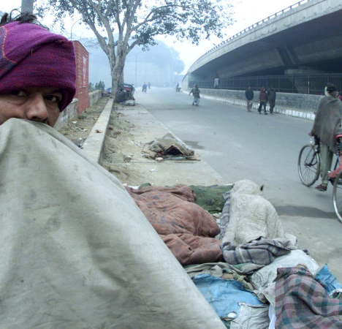
If only they had a blanket....
As many as 10,933 Indians (an average of 781 per year) have died over the past 14 years–between 2001 to 2014–due to “cold and exposure”, an analysis of statistics on accidental deaths due to natural causes obtained from the Open Government Data (OGD) Platform of Government of India reveals.

Slide 5
How can we change this?

Slide 6

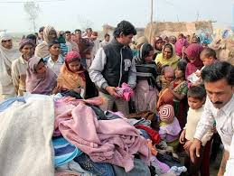
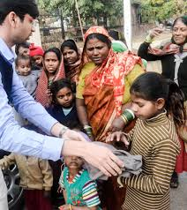
The answer is....Cre-Don
An online platform where you can donate your unused clothes in exchange for exciting credit points

Slide 7
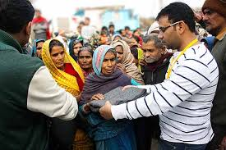
How does it work
Our services are app and website based. You need to be registered on our website or app to use our services.
When you select the donate option you’ll get the menu to decide what type and quantity of clothes you want to donate.
Our executive will visit your location for collection of clothes with preliminary verification.
After that, your donations go through several quality checks at our facility.
At last you are awarded credit points on the basis of your evaluation.

Slide 8
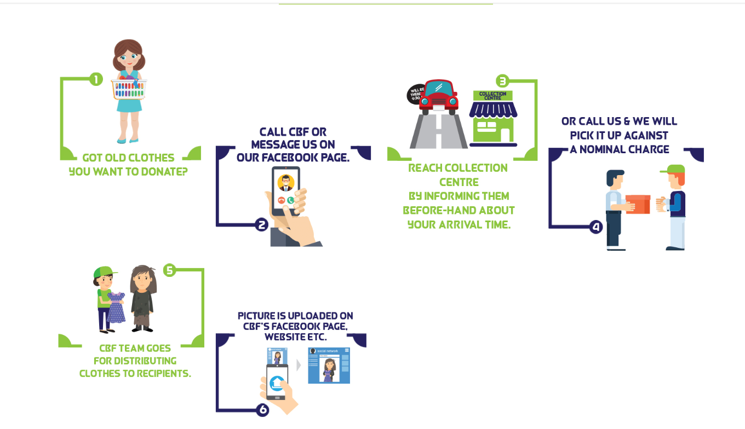

Slide 9
The Quality check
At our quality check facility we perform a thorough check on your donated belonging.
The clothes which satisfy the set parameters are then sent to various NGOs and social worker, who then give it to the ones in need.
The clothes which are not upto the mark are then sent to one of our recycling facilities.

Slide 10
Recycling procedure
The clothes which are not upto the mark are sent to a recycling facility where it is reprocessed to make something new
These new products are rebranded as our own and can be purchased from our very own retail stores

Slide 11
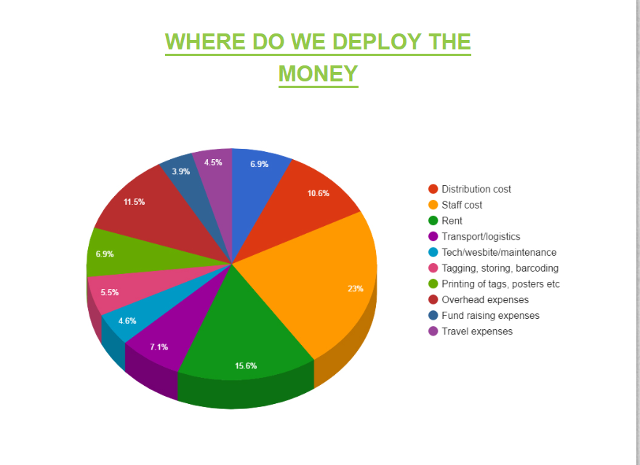

Slide 12
Our Partners...
Salons
Local Grocery stores
Stores and Marts
Restaurants

